Slide 1

IoT Chain
A high-security lite IoT OS

Slide 2
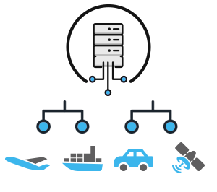
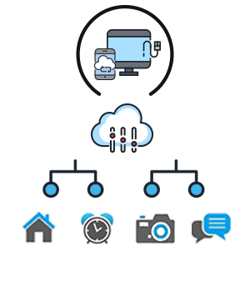
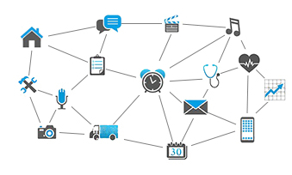
Future Society Made Up By IoT
Before2005
Today
2025 and beyond
closed and centralized
IoT networks
open access IoT networks
centralized cloud
open access IoT networks
distribuited cloud
On the basis of HIS’s prediction, most articles will be intellectualized by 2025. In the future world, everything will be interconnected, from a cup to a house, and they will have their own IoT OS.

Slide 3



Slow Growth of PC/Mobile phones VS Rapid Growth of IoT Devices
Resources: IDC/Zhiyan Consulting
According to Swedish Ericsson’s latest research report, the number of smart-phone users exceeded feature-phone users for the first time in 2016, but both of them will soon be surpassed by IoT devices in a few years. As estimated, the number of sensors, home appliances and machines connected to IoT will exceed phones and become the largest connection device in 2018. By 2021, among the whole world’s 28 billion connection devices, 16 billion of them will be IoT devices, from smart city, smart vehicles and smart home to mobile health care and diagnostic equipment.

Slide 4
IoT Market Scale
In 2016, expenses on IoT technical products and services by the whole world’s enterprises have reached 120 billion dollars and this number will increase to 253 billion dollars in 2021, with a compound annual growth rate of 16%. Over the next five years, the sole expenditure on IoT technical services will rise with a compound annual growth rate of 17%, reaching 143 billion dollars in 2021. To estimate on the compound annual growth rate of 20%, Asia will have the fastest growth, reaching around 35% of total expenditure in 2021.

Slide 5
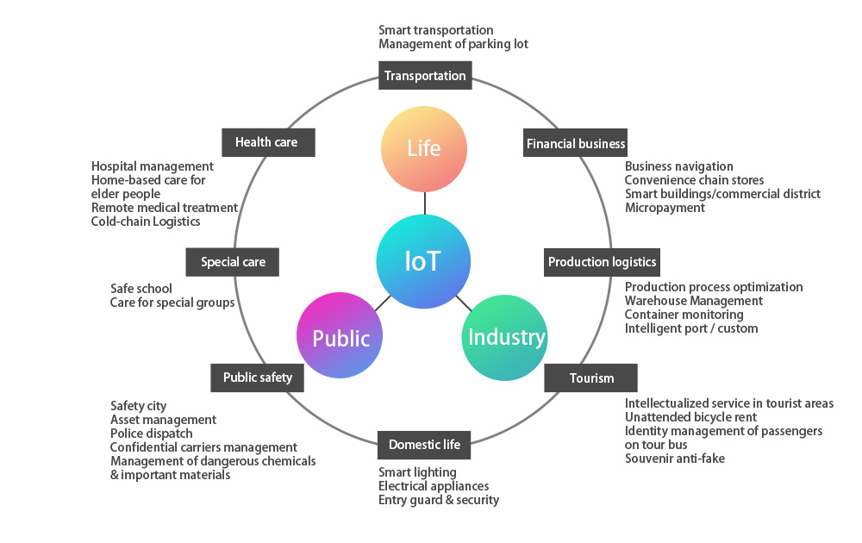
Overview of IoT Industry

Slide 6
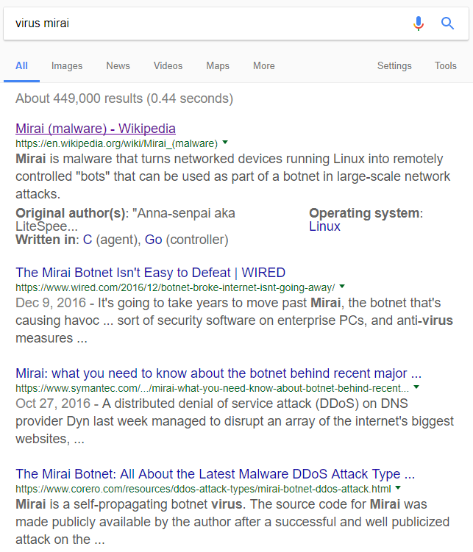
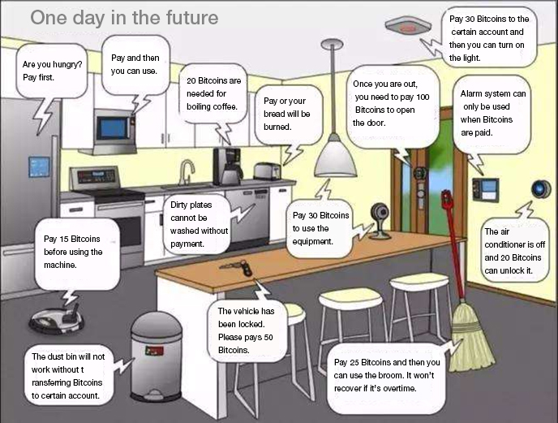
Possible Future

Slide 7


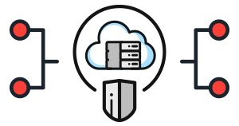
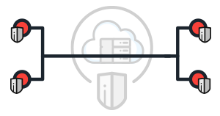
Challenge One: Low Security
The Botnets of Things created by Mirai was entitled as one of the Ten Breakthrough Technologies in 2107 by MIT Technology Review. According to the statistics, the Botnets of Things have infected more than 2 million IoT devices, for example, the cameras. The DDos attack launched by this made the network of American DNS service provider Dyn break down and users could not visit several popular websites such as Twitter and Paypal within a short time. Afterwards, more botnets appeared, including the one that hijacked the IoT devices to mine Bitcoins and the http81, which has larger scale and is more active.
Centralized management structure cannot prove its innocence and individual private data being revealed has happened occasionally. For example, in May, 2017, People’s Daily Online once reported that 266 cameras in Chengdu were enforced for webcast.
At present, the security model based on closed source (often called “security through obscurity”) has exposed its potential safety hazards and will be abandoned gradually and be replaced by a new security model, “security through publicity”. To realize this, it is necessary to upgrade the model to open source software. Though the current open source systems are still vulnerable to accidents and are of low availability, they are less prone to government interference and other targeted attacks. Therefore, the open source system will play an important role in home automation as well as networking of vehicles and other devices.
Solutions
IoT Chain (ITC) has adopted the asymmetrical encryption. As long as the private key is kept properly, the data cannot be cracked even if it’s collected. At the same time, all the nodes in ITC are equal, which protects the users’ privacy. Moreover, based on the character that block chain cannot be tampered, the manufacturers and service providers are not able to tamper the user’s all information.

Slide 8
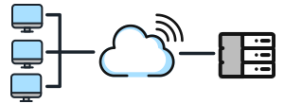

Challenge Two: High Cost
Before the revenue of IoT reaches market expectation, the cost of IoT is still extremely high. Many of the existing IoT solutions are of quite high expense. Besides the cost for intermediaries of these services, building and maintaining the basic facilities related to centralized cloud and large-scale server cluster are also very expensive.
But for IoT, the equipment manufacture enterprises don’t have enough profits to make up the money for supporting and maintaining the equipment for a long period. Meanwhile, it will cost a great deal of money to serve hundreds of billions of smart devices. Even the maintenance of centralized server for updating software will also cost a lot.
The operating costs of WeChat server for 600 million users have reached above 300 million yuan per month. Now there are 4.9 billion devices online, the annual operating cost of servers will be 29.4 billion yuan and the number is still increasing rapidly every year.
Solutions
The future ITC will surly have tens of thousands of nodes and they will be absolutely adequate to meet the needs of IoT data storage with a combination of blockchain’s distributed ledger technology. And thanks to the de-centralization of blockchain, there is no need for highly-intensive computer cluster. Both of the technologies have dramatically reduced the operating and maintaining cost of the whole IoT.
。

Slide 9
Advantages of Blockchain Solutions
1
The basic architecture of blockchain is immune to traditional internet attacks.
High Security
。
The features of decentralization, multi centers and weakening centralization will reduce the operation cost of centralized architecture.
2
Low Cost

Slide 10
Biggest Barriers to Blockchain Application:
High Resource Cost & Low Performance
Resource consumption
Data expansion
Performance bottleneck
Partition tolerance
The industrial IoT emphasizes that the nodes should be “always online” but it happens all the time that ordinary IoT nodes become failure and join or exit the network frequently. This will generate network shocks which consume a lot of network bandwidth and even cause “network partition”.
The limit speed of traditional Bitcoin trade is 7 transactions per second and it will take about one hour to write in the blockchain plus the time for consensus confirmation. This will lead to feedback and warning delay, which are infeasible in delay-sensitive industrial IoT.
Bitcoin’s POW (Proof of Work) is consensus mechanism with high resource consumption while most IoT devices have problems like low computing ability and network capability as well as short battery life.
With the growth of blockchain, can IoT devices provide enough storage capacity? Until now, Bitcoin needs 100 G physical storage space

Slide 11
Four Technologies of ITC
SPV
DAG
Lisk
CPS
SPBFT
For resource consumption, using super-voting consensus mechanism SPBFT can not only reduce the notice of resource consumption, but also speed up the transaction and lower transaction delay. Of course, there are certain losses in the extensibility of nodes and this will be adjusted through weight when facing a specific scenario.
For data expansion, ITC will apply simple payment mode (SPV) and compress transaction records through Merkle Tree. And for system architecture, heavy nodes as well as light nodes can be applied. The former ones will store blockchain’s all data and the latter ones will only store 256 hash values of Merkle Tree Root’s nodes for verification.
ITC has adopted DAG’s data structure to solve performance problems. On the one hand, the transaction performance can be improved. On the other hand, ITC can resist quantum attack. Meanwhile, Lisk has applied main chain – side chain and other cross-linked technologies to conduct management dividing into zones to greatly improve its performance.
ITC will adopt multiple CPS clusters to achieve partition tolerance and bear potential network partition risks. Also, ITC system will support both on-chain and off-chain transactions, especially the off-line transaction.

Slide 12
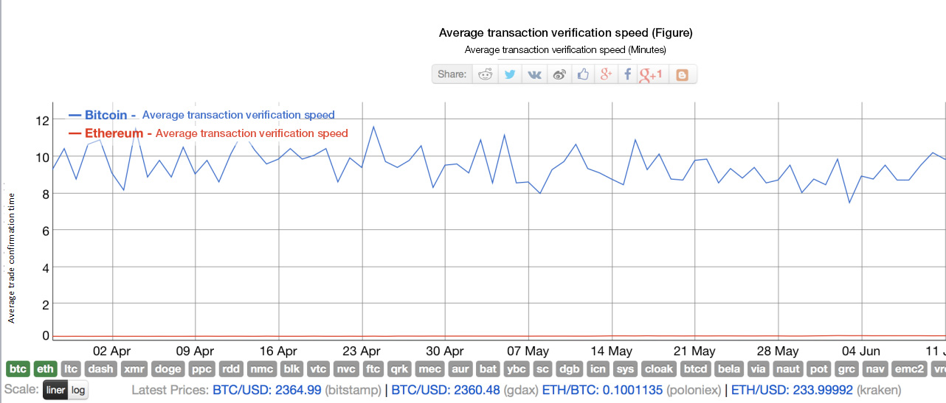
ITC Performance Analysis
Transaction verification speed：The speed of Bitcoin is about 10 minutes; The speed of Ethereum is about 10 seconds; The speed of ITC is millisecond.

Slide 13
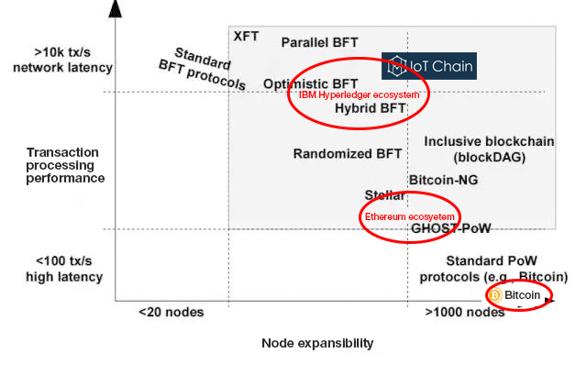
Performance Analysis of ITC Execution Efficiency

Slide 14

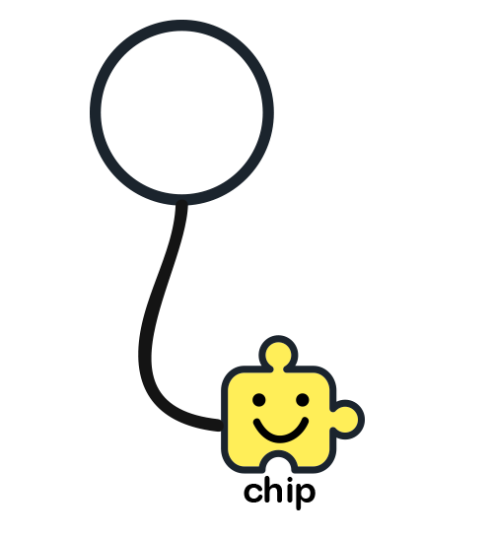
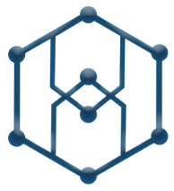
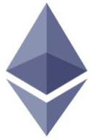


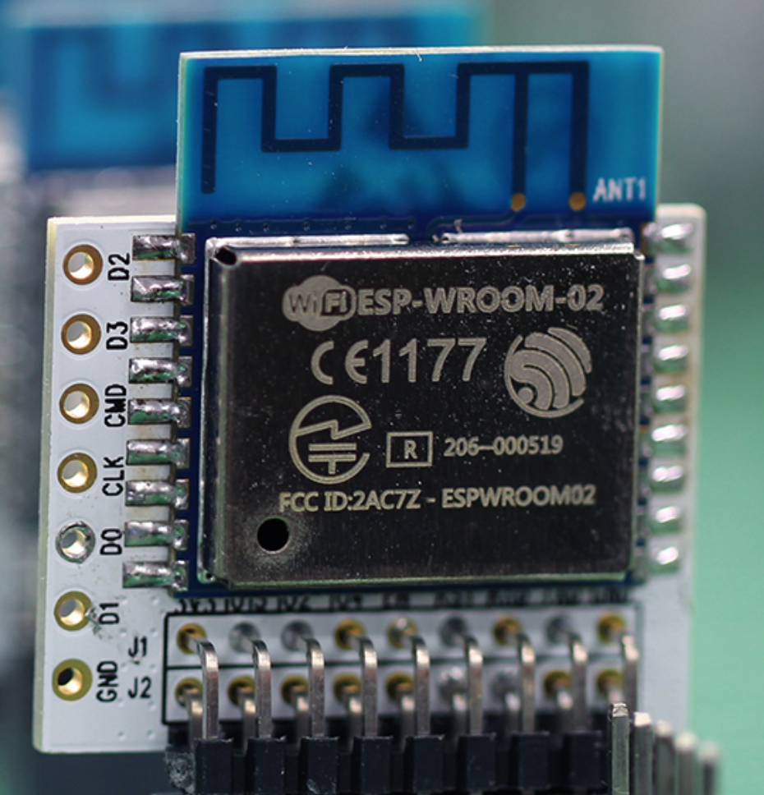
Comparison of Running Configuration: Traditional Blockchain VS ITC
Real size
Running configuration of traditional blockchain
Running configuration of ITC
Apple macbook
ESP8266
CPU: 0.08GHz
RAM: 0.002G
ROM: 0.012G
Size: 18 mm x 20 mm
CPU: Core Duo Quad 2.4 GHz
RAM: 8G RAM
Hard Disk: 1T
Size: 180 mm x 200 mm

Slide 15




Users’ Usage Scenario
Physical Equipment
IoT Blockchain
Module
Blockchain network
Mobile Phone APP
IoT linking module is the necessary component of IoT equipment. IoT module was updated to a new one which integrated blockchain authentication technology. In combination with DOA (Dead on Arrival) technology, this can guarantee the uniqueness of IoT assets.
The IoT Chain equipment, which has integrated IoT block module, can achieve security after being traditionally accessed to blockchin network. In this way, the cost can be reduced because blcockchain network doesn’t depend on servers.
When IoT users are using the APP control on their mobile phones, intergrated wallet program will automatically verify whether the IoT equipment is safe or not and show the asset information of this equipment timely.
All the IoT equipment can be intergrated into ESP8266 and use ITC IoT operating system.

Slide 16
Architecture of ITC Platform
ITC solutions
Blockchain IoT devices
Access chips
WiFi
Bluetooth
Zigbee
Devices intellectulization
RF
NFC
QR
M2M service module
IoT technology
Remote control
M2M
SDK
Open API
Message broker
Ordinary devices
+
=
Scenes linkage
IoT application port
APP
Open SDK
Blockchain wallet application port
Devices safety
Asset wallet
Access safety
Data safety
Block registration module
Asset certification module
Blockchain IoT
technology
Equipment capitalization
Digital asset transaction
Asset registration module
Connection with digital currencies
Asset safety module
Digital asset appreciation

Slide 17
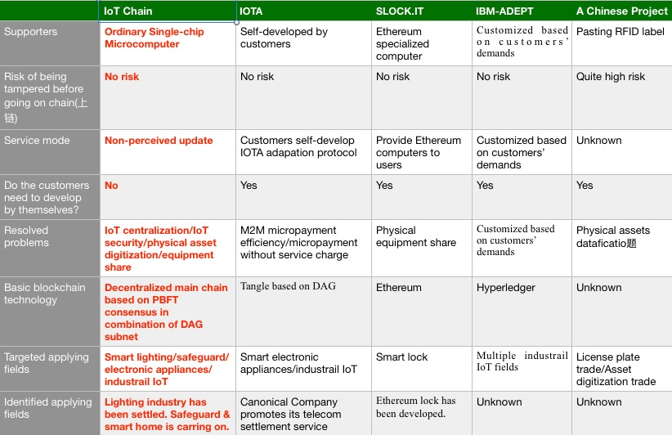
Competitiveness Analysis of ITC Business Mode

Slide 18




Technology R&D Schedule
R&D of basic chain accomplished.
Wallet test
R&D of IoT OS accomplishes.
Overall system operation test
December, 2017
February, 2018
May, 2018
February, 2019

Slide 19



Business Action Plan
Electronic equipment
Lighting field
Industrial IoT
The later half of 2017
The first half of 2019
2022

Slide 20
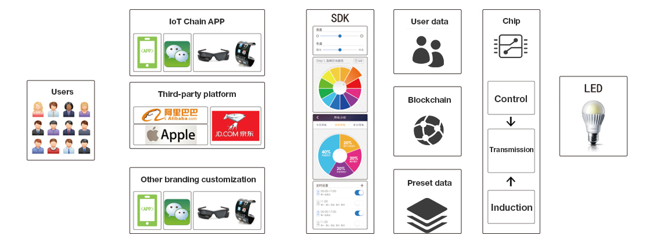
Smart Lighting Solutions

Slide 21
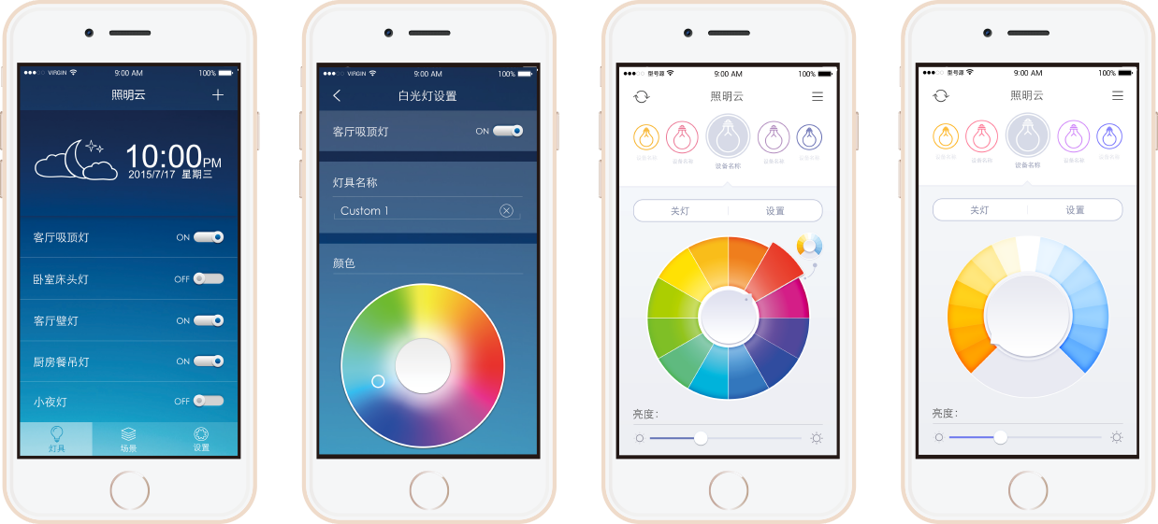
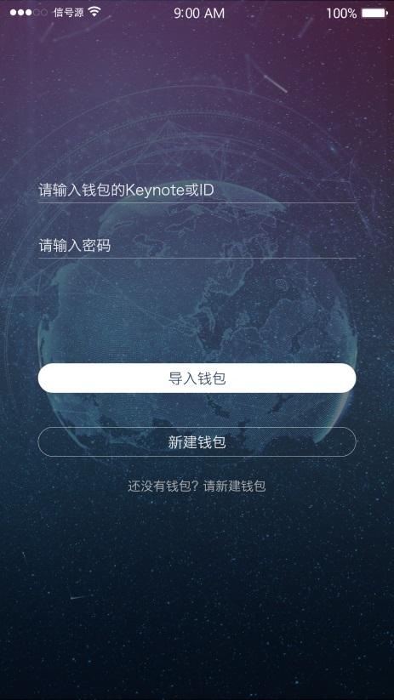
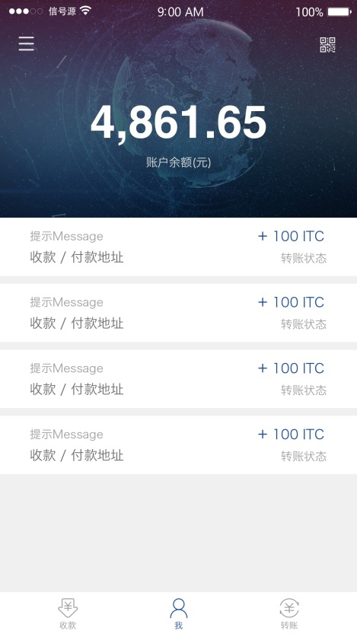
Blockchain IoT Lighting App
Digital Assets Wallet
Smart Lighting Control

Slide 22
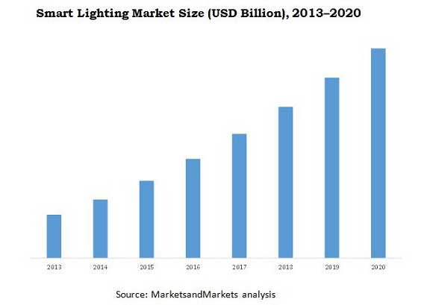
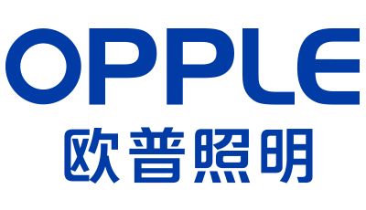
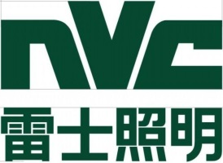
Why Us?
The biggest basic architecture of IoT is intelligent lighting devices and their nodes are distributed all over the world.
Shanghai Zhuonian Software Research and Development Co., Ltd. is the core provider of IoT technology for global top smart light companies

Slide 23
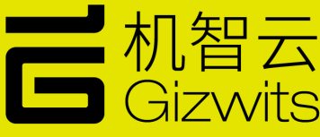

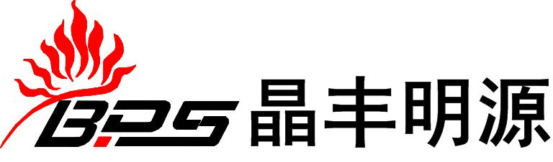



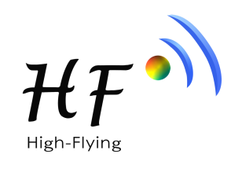


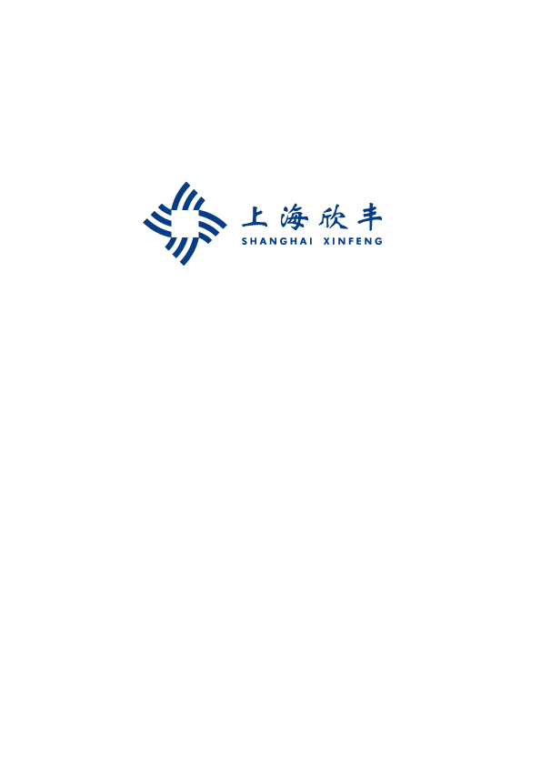


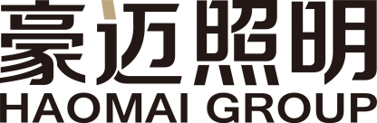
More Cooperative Brands in Various Fields

Slide 24

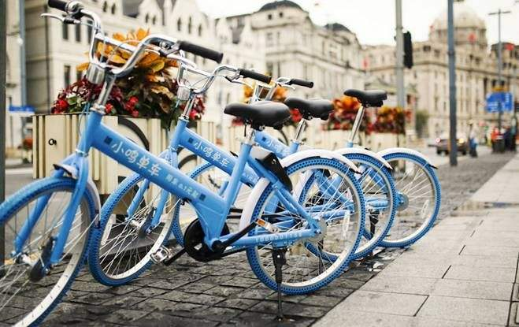
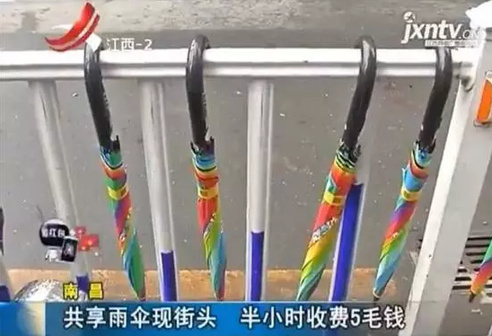
ITC Identified Cooperative Companies
The annual shipment of Lenze Technology is about 150 million chips. It is the core provider of smart lock’s chip for Xiaoming sharing bikes and of Hangzhou Paradise Umbrella’s sharing umbrellas. It also provides IoT chips for many other sharing equipment, such as sharing charge pal.
Cooperation：We have reached cooperation intent with Lenze and IoT chips will be gradually added to ITC project in the future. The ITC operating system will ensure the safety of its underlying IoT devices and help realizing safe sharing of everything.

Slide 25

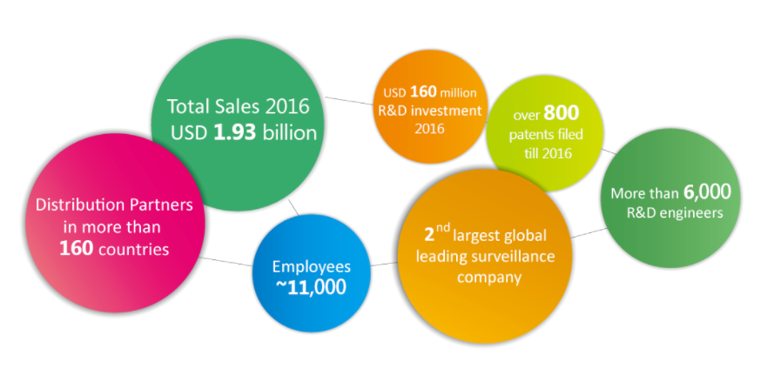
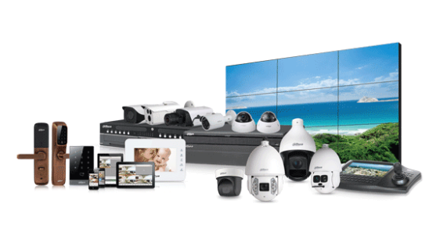
ITC Identified Cooperative Unit
Zhejiang Dahua Technology Co., Ltd.(Stock Code: 002236) is a leading solution provider in the global video surveillance industry with around 10,000 domestic partners and more than 300 overseas partners . Based on technical innovations, Dahua provides end-to-end video surveillance solutions, products, and services, creating values for urban operation, enterprise management and customer daily lives.
Cooperation: Apply ITC technology to protect the information security of its video surveillance system and the privacy security of its users.

Slide 26
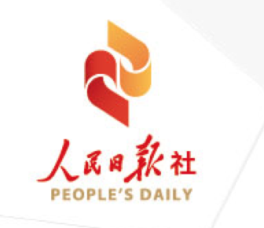
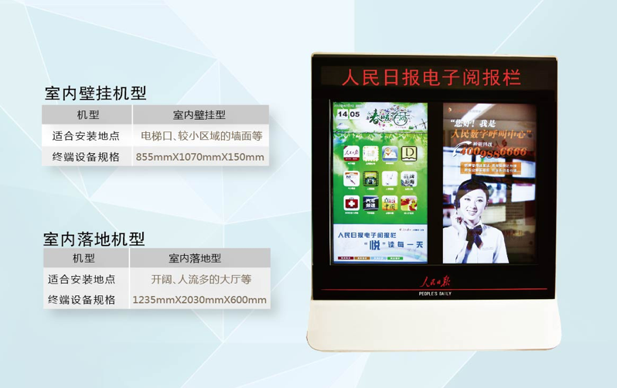
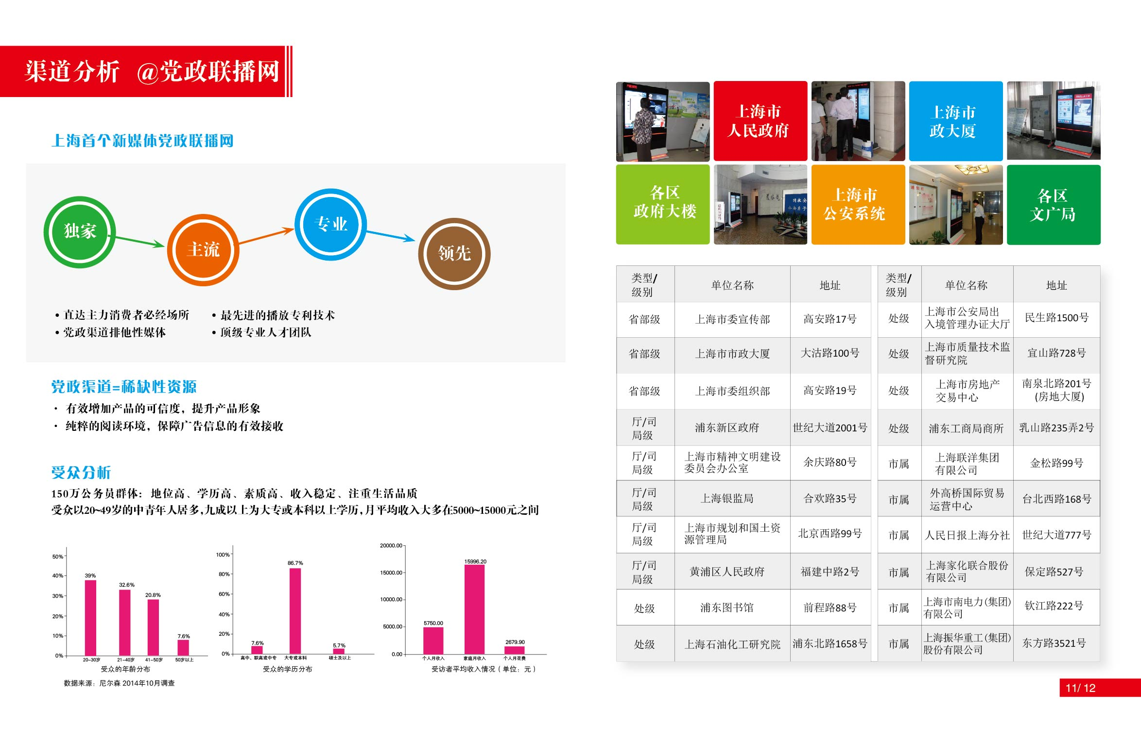
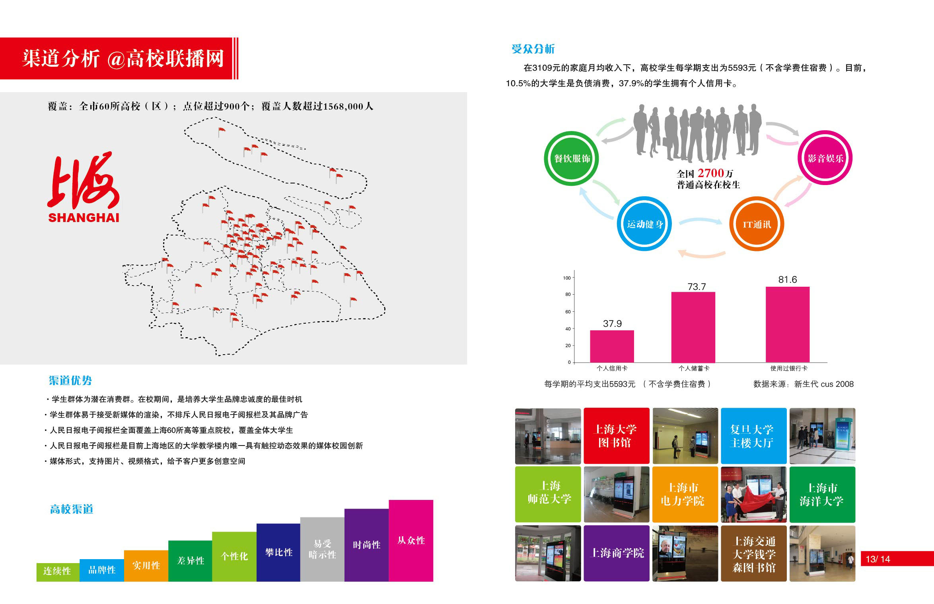
ITC Identified Cooperative Unit
People’s Daily Digital Communication (Shanghai) Co., Ltd. is subordinate to People’s Daily and is the only main organization in charge of setting and operating People’s Daily Electronic Reading Column in Shanghai. Up to June, 20017, more than 6,000 People’s Daily electronic reading columns have been set up in Shanghai, becoming the first authorized screen media which is based on Party and government organs (the only one) as well as colleges and universities (the first one) in Shanghai.
Cooperation: ITC operating system will ensure the information security of its electronic screens and protect the cloud from being invaded by Hackers releasing harmful information.

Slide 27
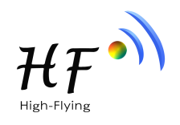
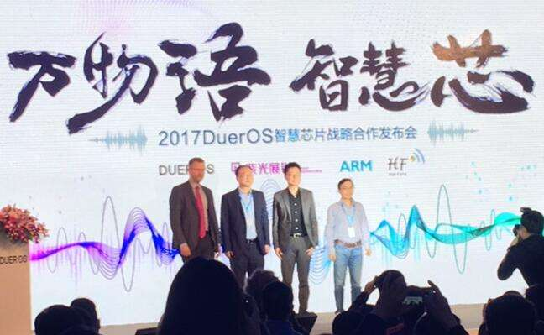
ITC Identified Cooperative Companies
Shanghai High-Flying Electronics Technology Co., Ltd. is a high-tech enterprises specialized in embedded wireless communication domain and designs, develops, manufacture and sells total IOT solution (Cloud Servers and Intelligent terminal APP) to the customer. High-Flying is the module provider for Baidu DuerOS of Ai Strategy.
High-Flying also launched smart light solution provided wireless solution for GE and CREE.
High-Flying is the core IoT chip company invested by Biadu.
Cooperation: Annual shipment of High-Flying is 15 million IoT chips. We have reached cooperation intent with High-Flying and IoT chips will be added to ITC project gradually in the future. The ITC operating system will ensure the safety of its underlying IoT devices.

Slide 28
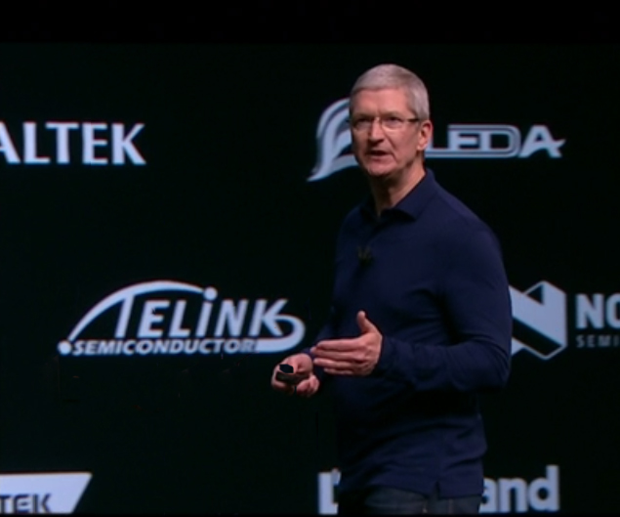
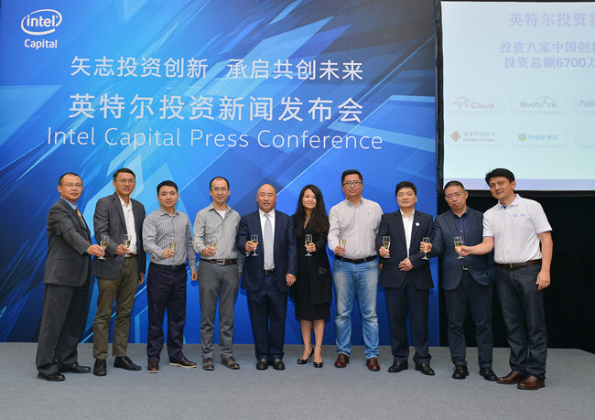
ITC Identified Cooperative Companies
Telink Semiconductor (Shanghai) Co., Ltd. ‘s major business is design and sale of integrated circuit chips. It also provides related technology consulting and technical service. Telink covers numerous markets including smart lighting, smart home, wearable products, and wireless peripheral, wireless toy, industry control, smart city as well as other IoT and consumer electronics.
On 2016 Apple’s New Product Release Meeting, Telink became Apple’s cooperative IoT partner.
GE has adopted Telink’s BLE Mesh technology in its smart lighting.
Telink was recently listed on 2016 Global Most Notable Newly-developing Semiconductor Enterprises selected by EE Times.
Telink has gained Intel’s strategic investment.
Cooperation：In the future, Telink module will all use ITC OS and as the underlying safety technologies, ITC OS will ensure the security of using Telink chips.

Slide 29
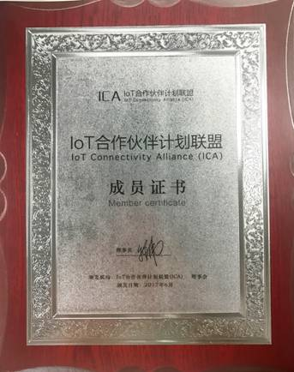
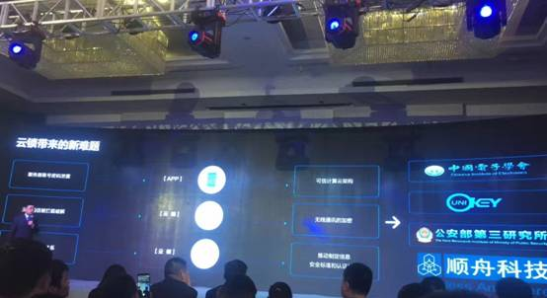
ITC Identified Cooperative Companies
Shanghai Shuncom Smart Technology Co.,Ltd. (Stock Code: 603515) has been dedicated to the field of wireless communication (ZigBee as the core) since its inception in 2004, while expanding the Wi-Fi, GPRS, 4G, Rola, NB-IoT and other communication technologies.
Shuncom is a member of Alibaba Smart Living IoT Alliance
Shuncom took part in Shanghai International Smart Home Exhibition.
Shuncom provides the first super-low-power-consumption module in this industry for Haier cloud lock.
Cooperation: In the future, all he smart lighting devices and municipal lighting devices will be accessed to ITC network to ensure its safety. 。

Slide 30

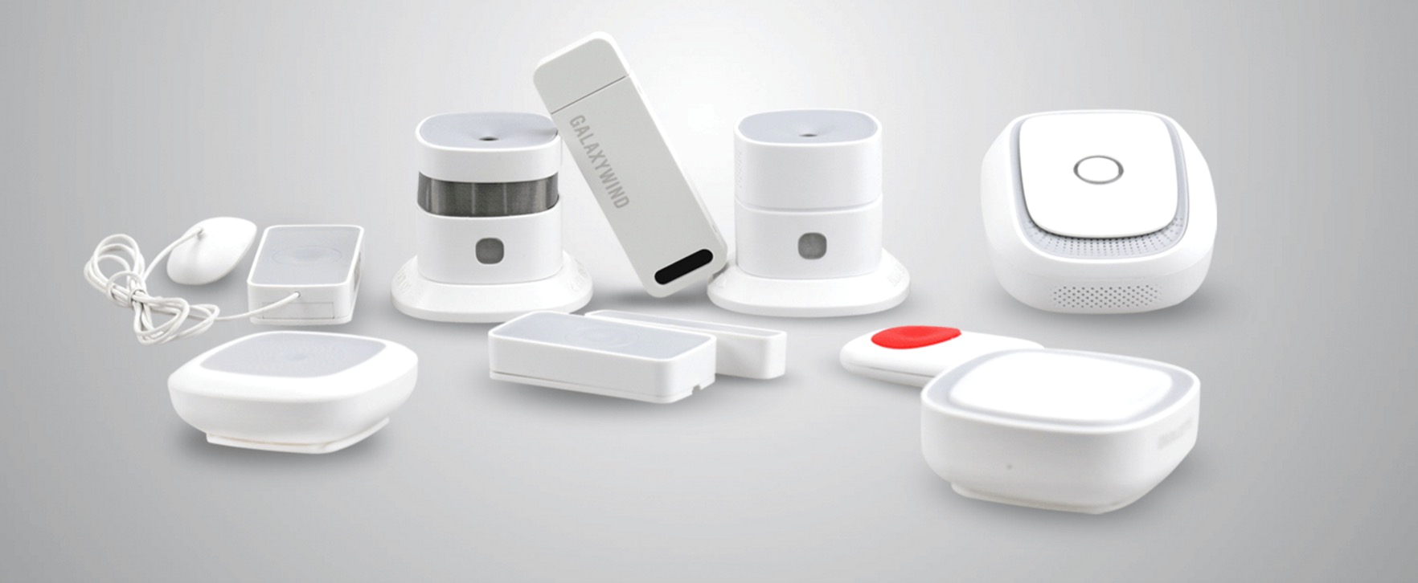
ITC Identified Cooperative Companies
Shenzhen Galaxywind Network System Co., Ltd. is responsible for research and development of Galaxy Super Computer. Galaxywind provides self-developed high-performance routers for special use or general use, exchange platform and security platform as well as total solution and technical service of smart home for government and users in all industries.
Cooperation: Dozens of electrical appliance companies have joined MACBEE alliance launched by Galaxywind and we have reached cooperation intent with MACBEE， whose members will all adopt ITC to ensure their IoT network’s security.

Slide 31
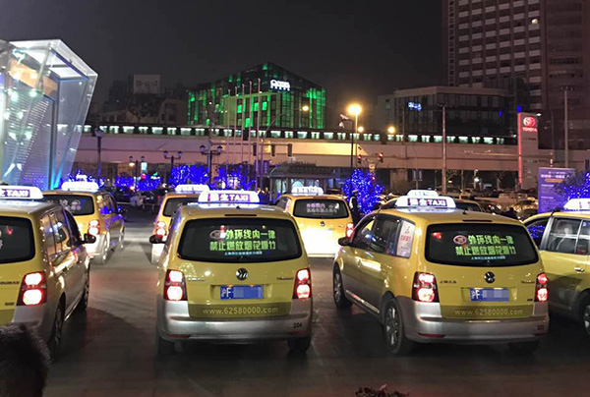
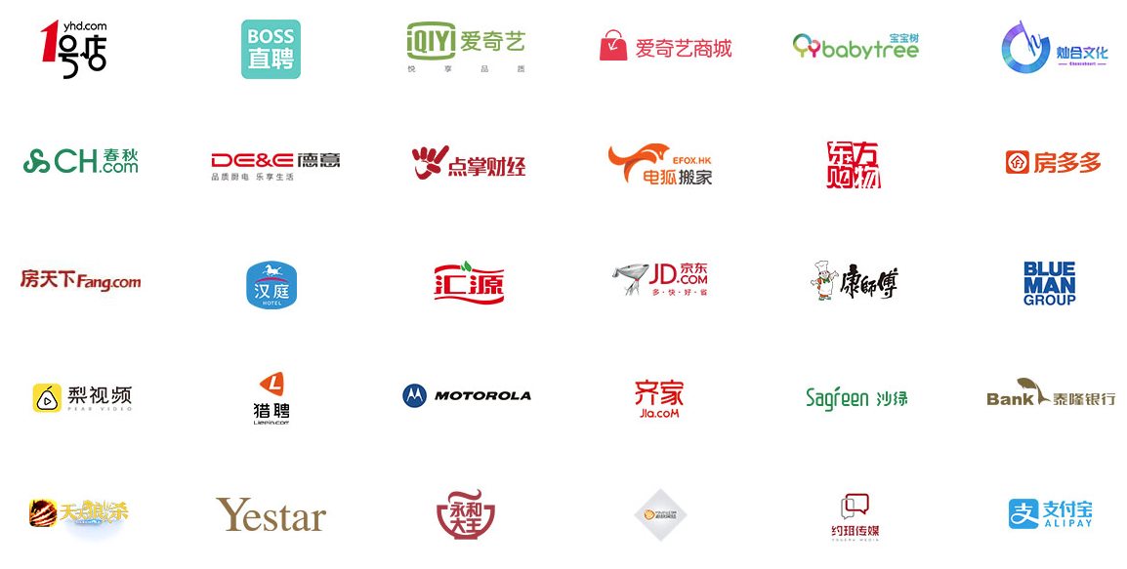
ITC Identified Cooperative Companies
Shanghai Be-Tiger Network Technology Co.,Ltd. was founded in 2015 and first created the brand new outdoor media -- TBA (Taxi Back-window Advertising). Be-tiger has long devoted to internet application in automobiles, building man-automobile internet ecosystem through cloud computing and many professional technical methods.
Cooperation: Since outdoor advertising medium is sensitive industry, it will cause great harm to the society if bad information is released by hackers who invade its centralized delivering cloud. ITC technology can efficiently protect the safety of advertisement contents.

Slide 32



ITC Core Team
Senior entrepreneur in IoT field
He has been engaged in smart hardware field for four years and has profoundly studied blockchain for three years. Xie has deep insights in smart hardware and was invited to address speech in many summits of smart hardware. He has participated in designing smart lighting architecture for several lighting companies at home and abroad. Besides, he has taken part in many designs of smart hardware architecture.
CEO
Xie Zhuopeng
Expert in Code & Hardware Encryption
Ding is a master of Hangzhou Dianzi University, majoring in Digital Image Processing. He was once the R&D supervisor of firmware in Huahong, the famous chip design company, and was in charge of developing the chips of UnionPay credit cards.
CTO
Ding Ying
Multinational financial management expert
Zhao Tan, MBA of MIT, CPA of China, Singapore and United Kindom (chartered). He once was the Asia Pacific CFO of Kerry and was in charge of foreign exchange hedging of hundreds of millions of dollars, strategic planning of cross-border capital, management of cash flow and building banking business system (J.P. Morgan). He once worked on auditing and IPO in China and Singapore’s KPMG. Zhao has abundant experience in financial management, financing and IPO and is quite interested in financial techniques innovation.
CFO
Zhao Tan

Slide 33


ITC Core Team
Expert in IoT Field
Liao has engaged in smart hardware field for four years and led in designing the smart lighting architecture of the world’s top-one lighting company. He has studied blockchain technology for three years and mastered java, C++, ruby, mqtt and blockchain
Major Programmer
Liao Dongnian
Expert in IoT Field
Hu has engaged in smart hardware field for four years and started to do research in blockchain IoT technology since 2013. He once participated in researching and developing IoT architecture design of an international famous brand. Also, he once was the technical manager of installment business department of Tongcheng Tourism Petty Loan.
Major Programmer
Hu Yasheng

Slide 34

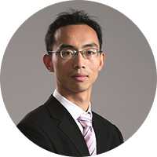

ITC Consultant Team
Liang Ran：As an expert in blockchain technology, Liang mainly studies the issue and transaction of assets in blockchain. He co-edited the ChinaLedger Whitepaper as well as China Blockchain Technology and Application Development Whitepaper issued by MIIT and he is the judge of MIIT First China Blockchain Development Contest. Also, he is the co-founder of RippleFox (RippleFox is China’s biggest Ripple and Stellar’s gateway and the leader of Chinese community of both Ripple and Stellar.
Zhou Shuoji: Zhou is the founding partner of FBG and he is an expert in digital currency transaction as well as an active investor in blockchain field. As one of China’s early pioneer practitioner of blockchain technology and the opinion leader of China digital currency community, Zhou has started and managed two digital-currency private transaction funds.
Ma Zhiwei: Vice president of Opple Lighting Co., Ltd (603515). After Opple’s going public, it became the world’s largest lighting company with more than 30 million yuan market value.

Slide 35



ITC Consultant Team
Ji Xinhua: Master of Shanghai Jaitong University and winner of first prize of Shanghai science and technology advancement. Ji took part in establishing standards for Unionpay credit cards’ encryption chips and for Central Bank’s digital currency.
Sheng Wenjun: Founder of Telink. He got his bachelor, master and doctor degree from Tsinghua University. Telink gained Intel strategic investment and is also the cooperative partner of IoT.
Qiu Haiyi: Founder and general manager of High-Flying. High-Flying is the distributor of Ai chips and the only IoT enterprise invested by Baidu. The annual sales volume of High-Flying chips is about 15 million

Slide 36
THANK YOU

